Slide 1
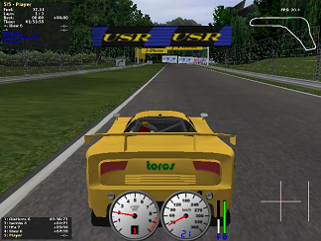
Evolving Driving Controllers using Genetic Programming Marc Ebner and Thorsten Tiede

Slide 2
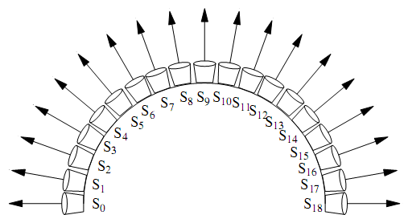
The Torcs Simulator
30 different tracks.
42 different cars.
50 optional opponents.
19 distance sensors .
Can be steered using a joystick, an actual steering wheel , the mouse or the keyboard.
Up to 4 different players can race against each other using a split screen mode.

Slide 3
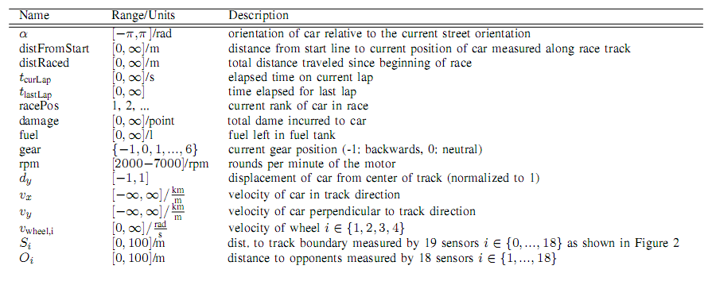
Sensors Available From A Simulated Car Of The Racing Simulator

Slide 4
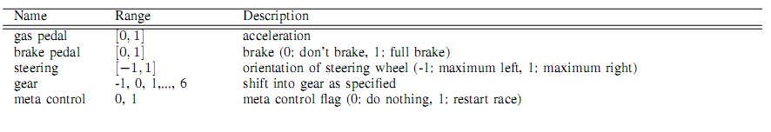
Actuators Of A Simulated Car Of The Racing Simulator

Slide 5
Evolution Of Virtual Race Car Drivers
Target - complete the race in the shortest amount of time.
The drivers are selected using the Darwinian
principle “survival of the ﬁttest”.

Slide 6
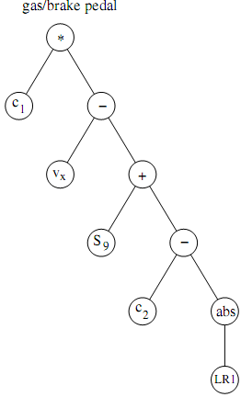
Implemantaion
tree-based Genetic Programming
Tree - Program.
external nodes - provide input to the program.
internal nodes – operations.
Each individual consists of two trees:
steering wheel - computes the steering direction.
gas/brake system - computes whether the car should
accelerate or decelerate.

Slide 7
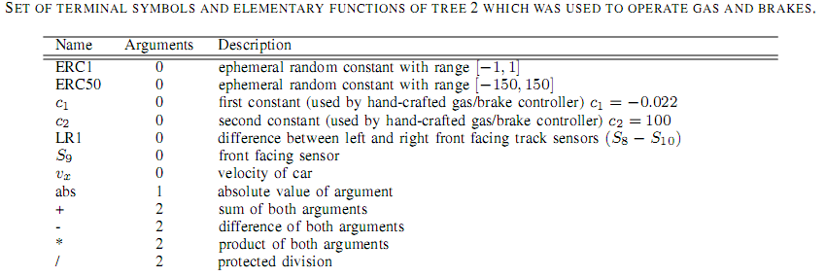
Gas/Brake Tree

Slide 8
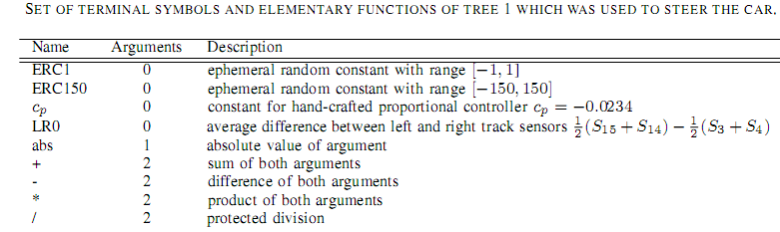
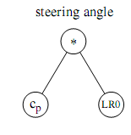
Steering Tree

Slide 9
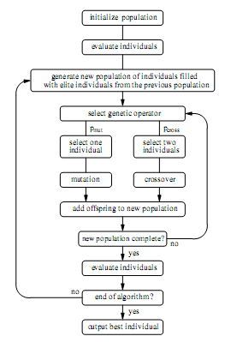
The Algorithm

Slide 10
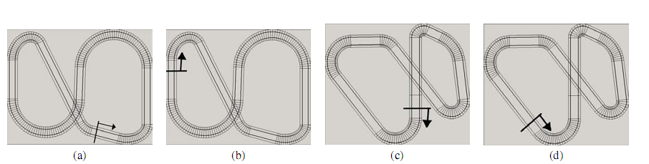

The Tracks
- Each individual is evaluated for 1000 time steps on each track.
- No other drivers are present on the track during evolution.

Slide 11
Fitness Function
F = Σf_{i} / 5 ,i ∈ {1, 2, 3, 4, 5}
f_{i} = d_{max} – d
d - the distance traveled along the track.
d_{max} = (maxTimeSteps/timeStepsPerSecond)*v_{max}
v_{max} - the maximum velocity of the car.

Slide 12
Selection
Elitism - The best 3 individuals are always copied into the next generation.
tournament selection
Tournament size = 7.

Slide 13
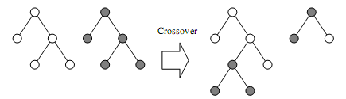
Crossover
selects two individuals and then exchanges two random subtrees between these two individuals.

Slide 14
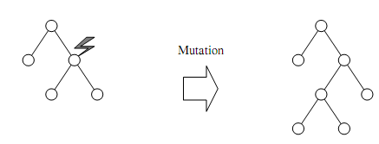
Mutation
A randomly selected node is replaced by a
newly generated subtree.
Each operator is applied with a probability of 50%.
Internal nodes are selected with a probability of 90%
and external nodes are selected with a probability of 10%.

Slide 15
The Experiments
4 experiments
Experiment 1: manually constructed individual inserted to the first generation.
Experiment 2: all individuals selected randomly.
Experiment 3: same as experiment 1 ,but with
an extended function set.
Experiment 4: same as experiment 2 ,but with
an extended function set.
Population size – 200 individuals in each experiment.

Slide 16
The Extended Function Set
The extended function set include 2 additionally functions
Sum : takes a single argument and sums up this argument over all time steps.
Last : returns the value which was computed during a previous evaluation of the node.
By adding these two elementary functions it is possible to evolve PID controllers in experiments 3 and 4.

Slide 17
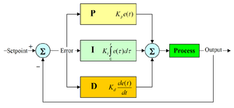
PID controller
A PID controller calculates an "error" value as the difference between a measured process variable and a desired set point.
The PID controller calculation (algorithm) involves three separate parameters; the proportional, the integral and derivative values.

Slide 18
The Results
Experiments 1 and 3 created the best car drivers after 50 generations.
Starting from an entirely random population (as in Experiments 2 and 4) made the problem more difﬁcult (statistically signiﬁcant with a conﬁdence of 94.7%).
There is no statistical signiﬁcant difference between
experiments 1 and 3 and also not between 2 and 4.

Slide 19
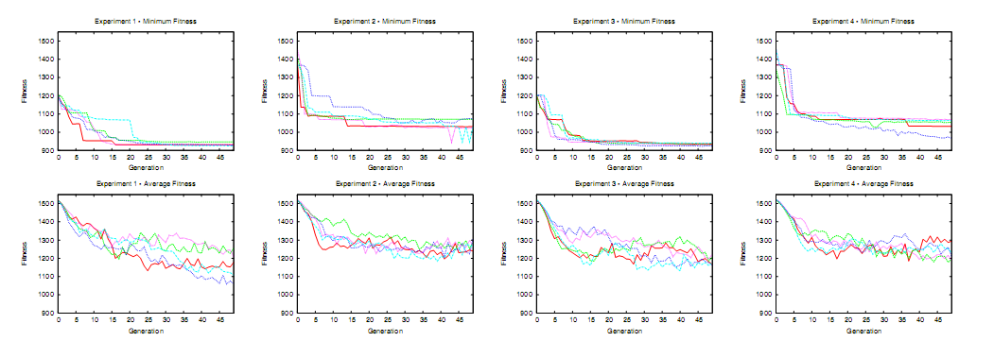
The Results

Slide 20
The Performance Of The Best Evolved Driver
The best car at generation 0 left the track when evaluated on tracks (c), (d), and (e).
At the first generation, the best individual is able to drive
for a maximum distance of 498m (on track (b)).
At the end of evolution the best individual was able to cover a
distance of 642m for this same track.
On track (e), the best controller from generation 0 actually left the track after only 66m.
after generation 50, it was able to drive for 624m on track (e) without leaving the track.
The best evolved controller uses only the current speed and the front facing sensor (S9)to control the acceleration of the car.

Slide 21
The End.

